Slide 1
The CHAMP Plan ™
Introducing
Engage | Educate | Monitor | Manage

Slide 2
Companies The CHAMP Plan™ Works With

Slide 3
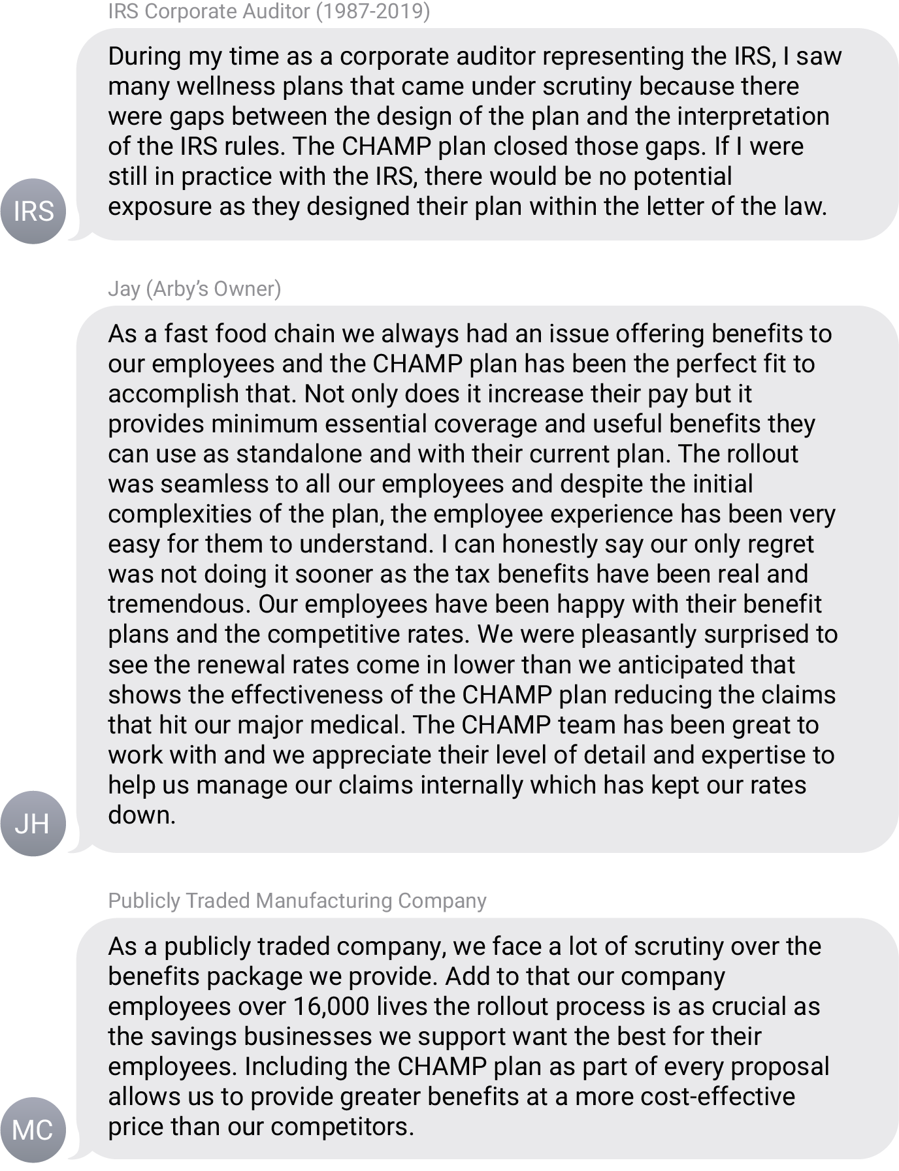
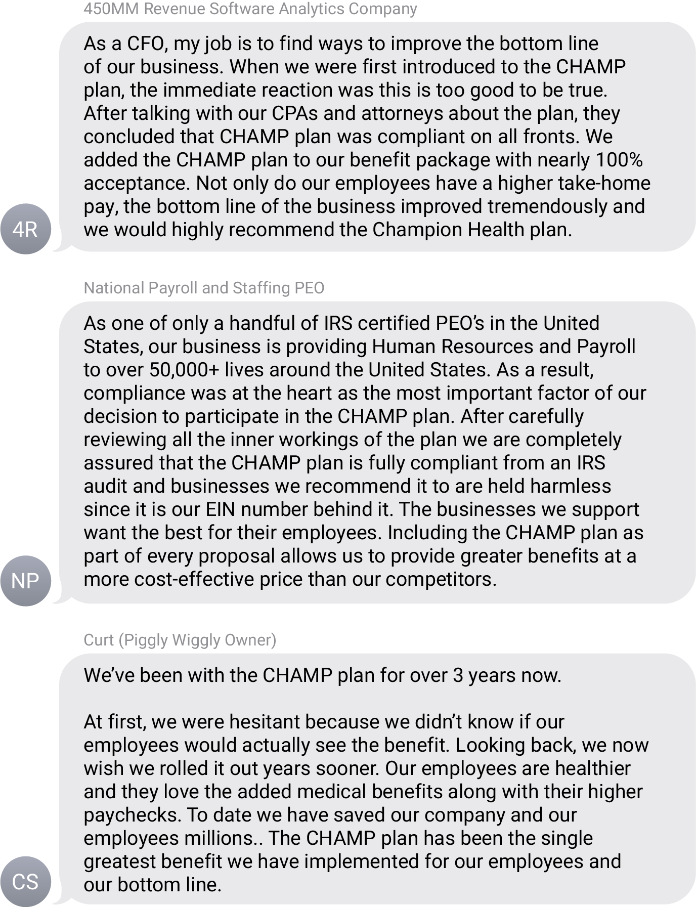
The CHAMP Plan™ Testimonials

Slide 4
The CHAMP Plan™ Benefits
Unlimited Primary Care Doctor / Urgent Care Visits
The Plan pays 100% of the office visit charges for First Health Providers for the employee. (Employee Only)
100% Preventative Care
The Plan pays 100% of services required by the Patient Protection and Affordable Care Act through First Health Providers. (Employee Only)
Unlimited Prescriptions $0 Copay
No copay or cost (Employee plus family)
Direct Primary Care (Employee plus family)
$0 Cost Unlimited access to a Concierge’s advocate approach to health care.
It’s having a doctor available 24/7 at your beck and call.
Personal Health & Mental Health Consultations (Employee Plus Family)
Proactive Medical Care to help identify potential health risks
Access to private consultations
Benefits are available to Employees, Employees + Spouse/Partner and Children. See details on Fulfillment documentation.

Slide 5
The CHAMP Plan™ Benefits
Direct Primary Care
Our Board-Certified Doctors can diagnose your symptoms,
prescribe medication and send prescriptions to your pharmacy of choice.
We treat most non-emergency conditions such as:
Mental & Behavioral Health
Licensed Therapists and Counselors available anytime, anywhere.
Talk to us for issues such as:
Abdominal Pain/Cramps
Abscess
Acid Reflux
Allergies
Animal/Insect Bite
Arthritis
Asthma
Backache
Blood Pressure Issues
Bronchitis
Bowel/Digestive Issues
Cellulitis
Cold
Constipation
Cough/Croup
Diarrhea
Dizziness
Eye Infection/Irritation
Fever
Flu
Gas
Gout
Headache/Migraine
Herpes
Joint Pain/Swelling
Laryngitis
Pink Eye
Poison Ivy/Oak
Rash/Skin Injury
Respiratory Infection
Sinusitis
Sore Throat
Sprains & Strains
STD’s
Strep
Tonsilitis
Vaginal/Menstrual Issues
Yeast Infection
And More
ADHD
Addictions
Anger Management
Anxiety
Bipolar Disorders
Bullying
Career/Job Related Stresses
Child and Adolescent Issues
Depression
Divorce
Eating Disorders
General Life Coaching
Grief and Loss
Life Changes
Nutrition Counseling
Panic Disorders
Parenting Issues
Postpartum Depression
Relationship and Marriage Issues
Self-Image
Stress
Substance Abuse
Trauma and PTSD
And more

Slide 6
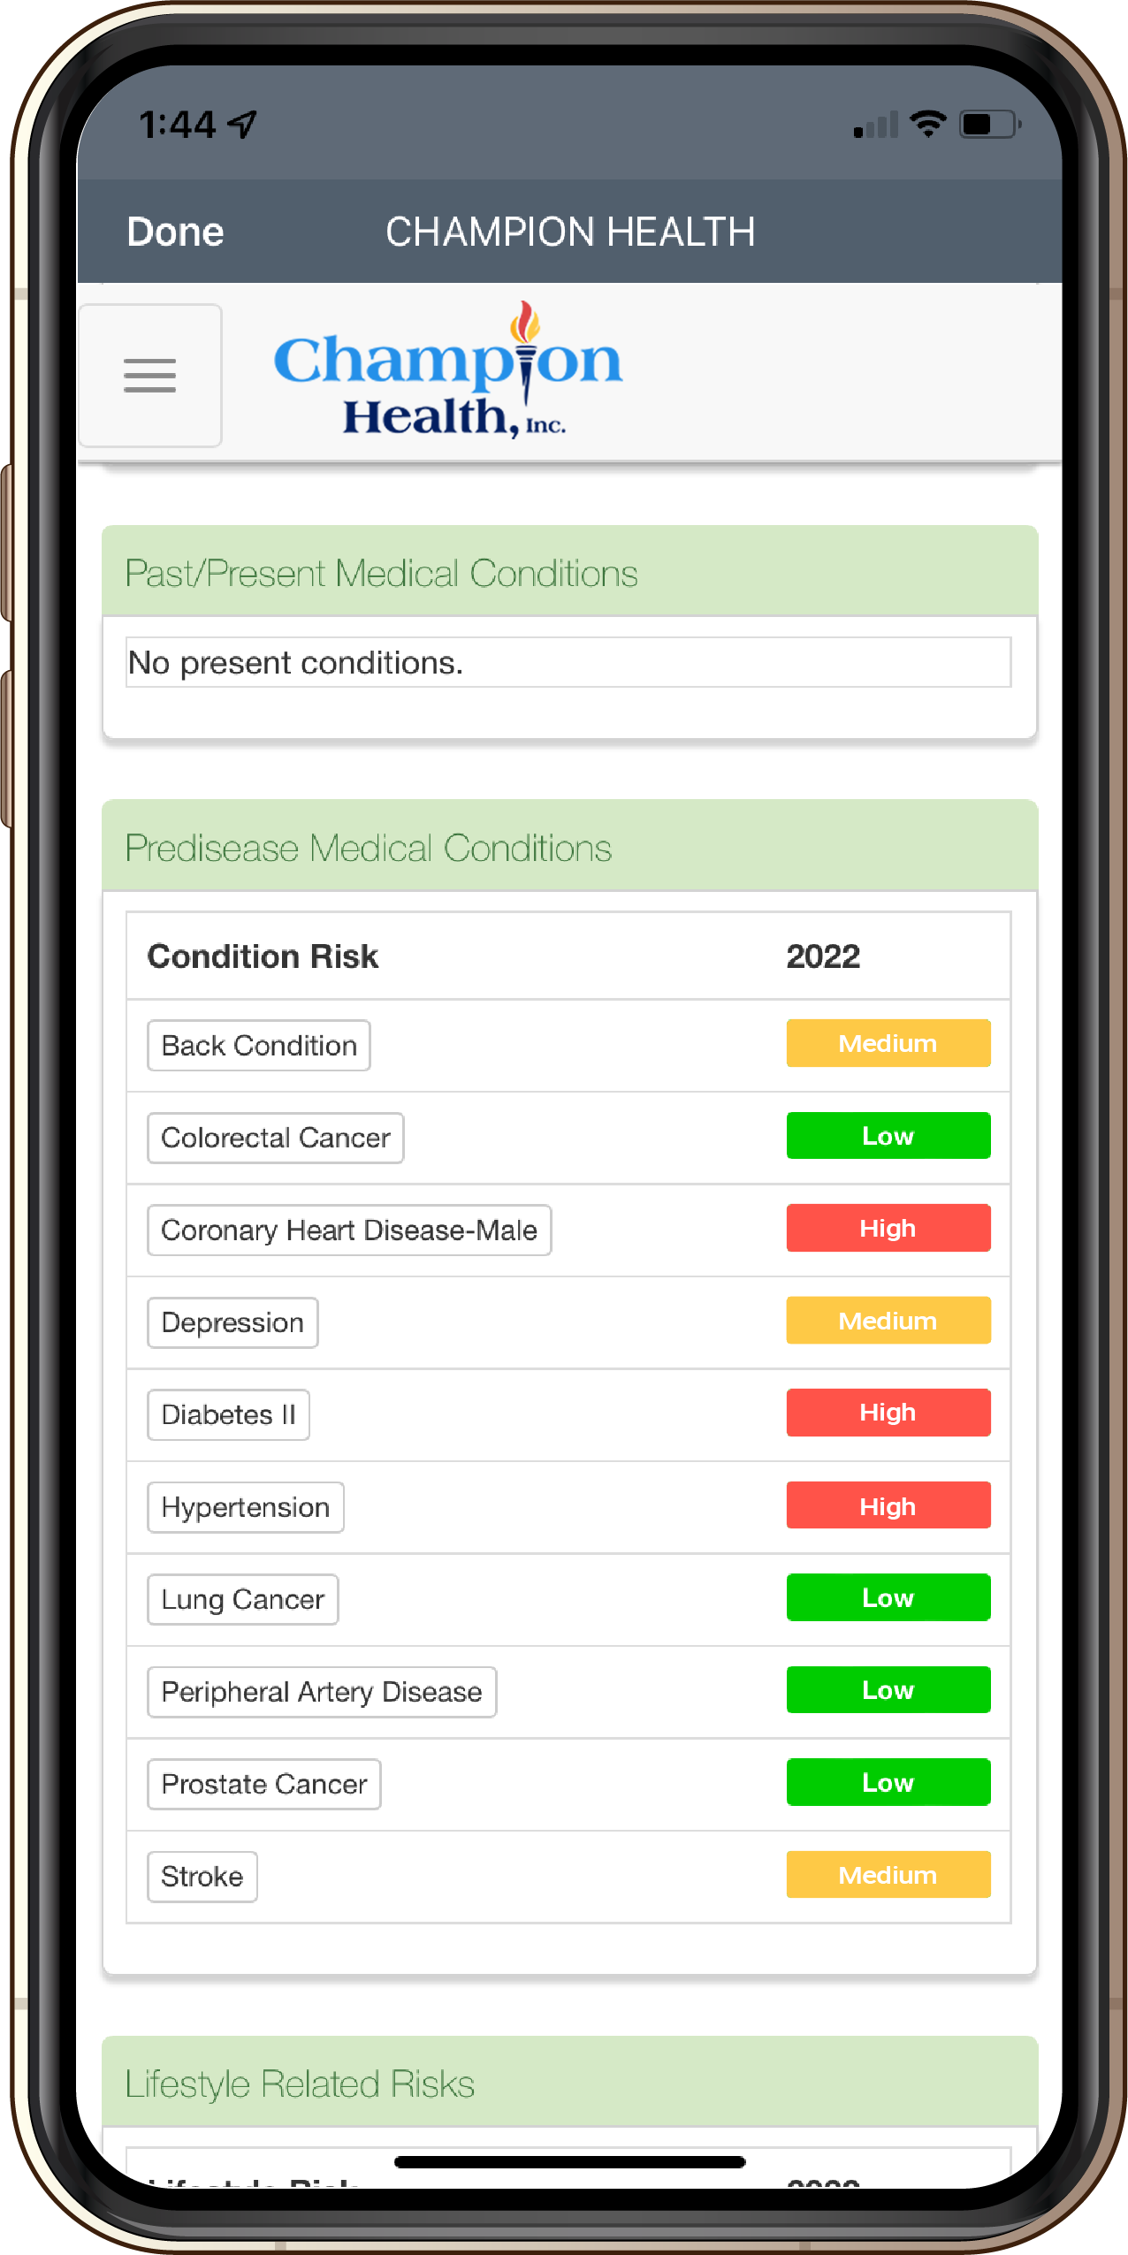
The CHAMP Plan™ Predictive Med Model
Advanced Technology Based Personal Health Management
Multi-channel solution:
Mobile App / Tablet
Desktop Online Internet Portal
Physical Intervention
Proven outcomes spanning 20 years and a global stage
Care coordination with The CHAMP Plan™ providers

Slide 7
How is The CHAMP Plan™ Different?
PredictiMed™ VALIDATED* next generation
Analytics & Predictive Modeling Tools
* Validated Through Intel-GE Care Innovations Validation Institute, Care Innovations
Segmented Pre-disease Predictive Model™
Segmented End-stage Predictive Model™
Fully integrated proprietary technology/service platform includes:
Personal Health Dashboard™, behavioral modification programs, rewards, personalized health content, risk resolution guidelines, claims and payor administration, Wholeistic™ coaching tools, Champ™ Score, Benefits linkage tools

Slide 8
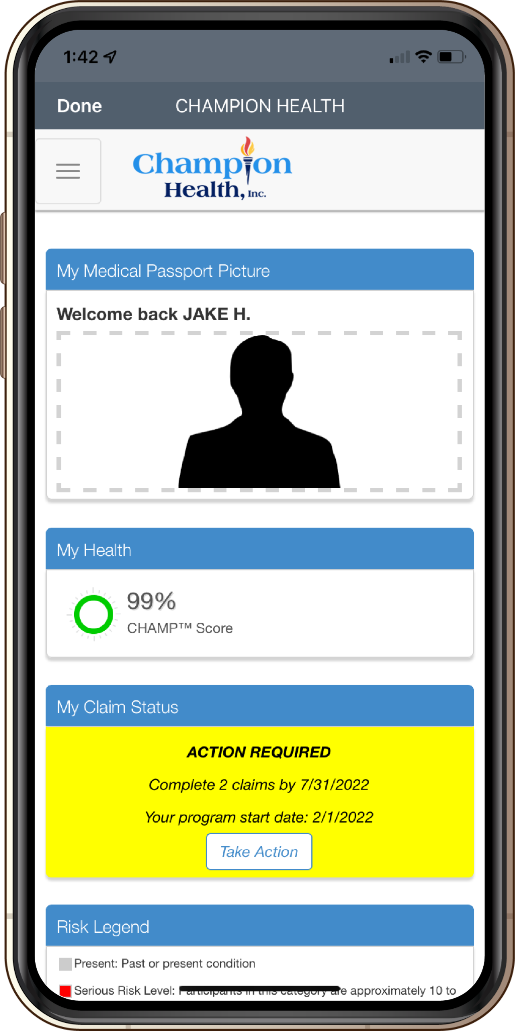
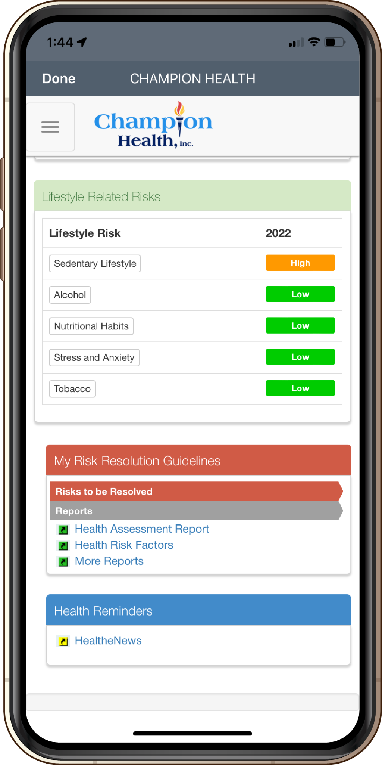
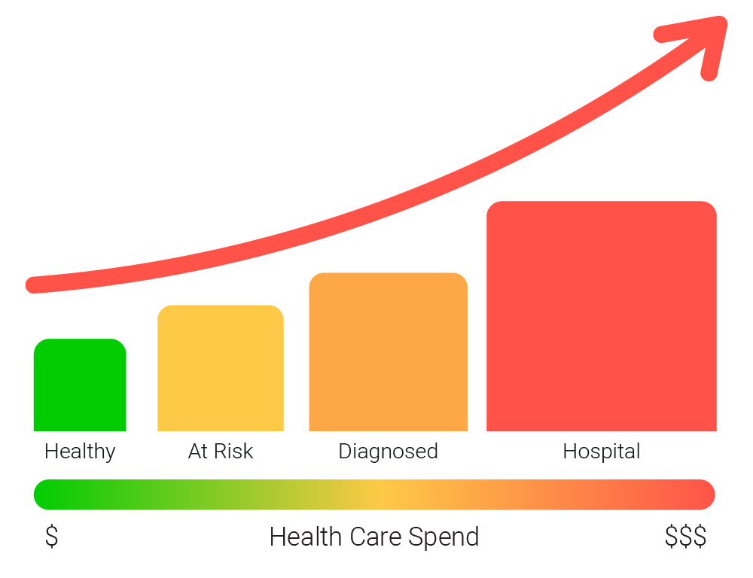
The CHAMP Plan™ Predictive Med Model

Slide 9
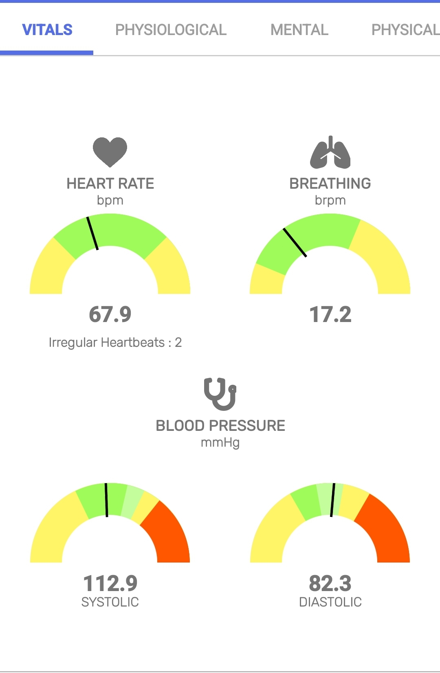
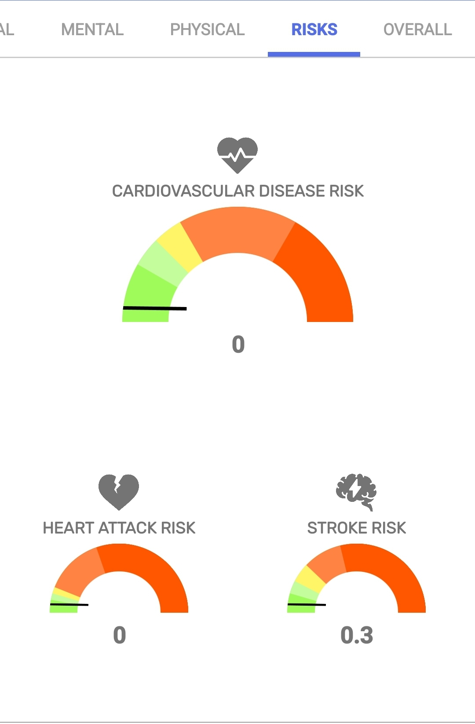
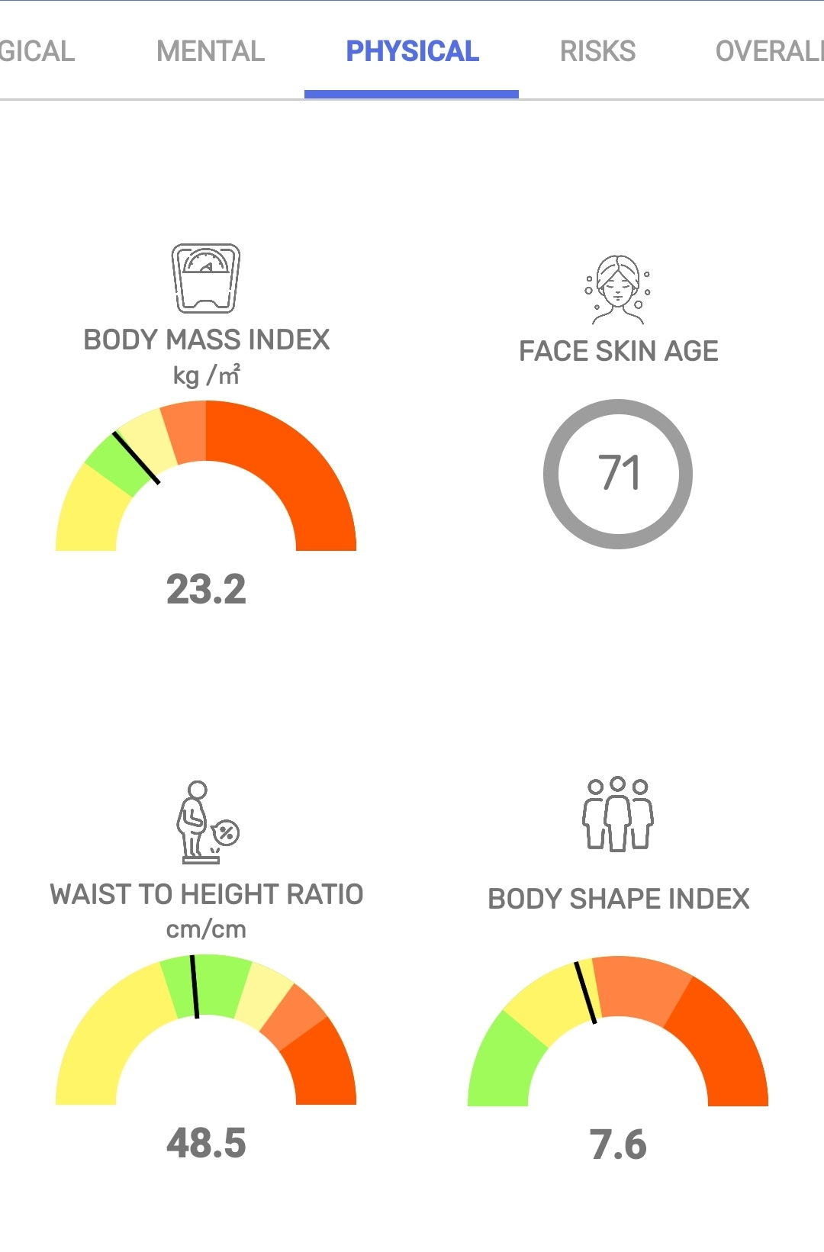
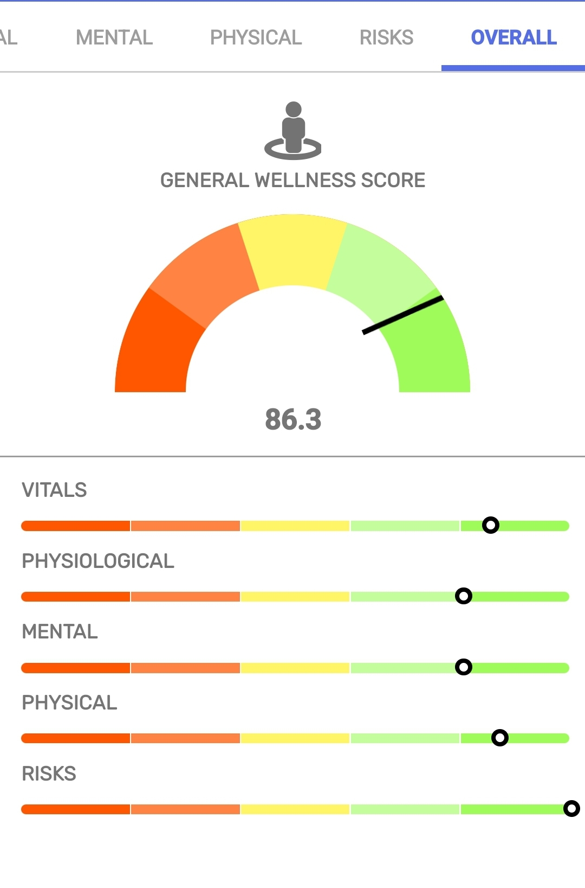
The CHAMP Plan™ Face Scanner Application
Employees can use the FDA registered scanning technology to capture a large range of health information that they can use to improve upon and track their progress over time.
36

Slide 10
The CHAMP Plan™ Qualifying Triggers
Watch Video and Complete Clinical Quiz
Complete Wellness Modules
Complete Assessments
& Risk Resolution Guidelines
CPT 96161
Keeping Your Back Healthy / Depression / Prediabetes / Managing Your Weight / Guide to Physical Activity / Relaxation Exercises / Smoking Cessation / Stages of Change / How Your Heart Works
CPT 98969
Nutrition / Stress / Fitness / Tobacco Cessation
CPT 96161
Health Risk Assessment with Champ™ Score / CHAMP Wellcentive / Absenteeism & Presenteeism / Quality of Life / Readiness to Change / Health Utilization / Alcohol / Overweight / Sedentary Lifestyle / Stress / As applicable based on risk
Biometric Screening
CPT 80047-
86849
Coaching with RN
CPT 98967
Visit with Telemedicine Provider
CPT 99091
Coaching with Doctor
or Physician
CPT 98967

Slide 11
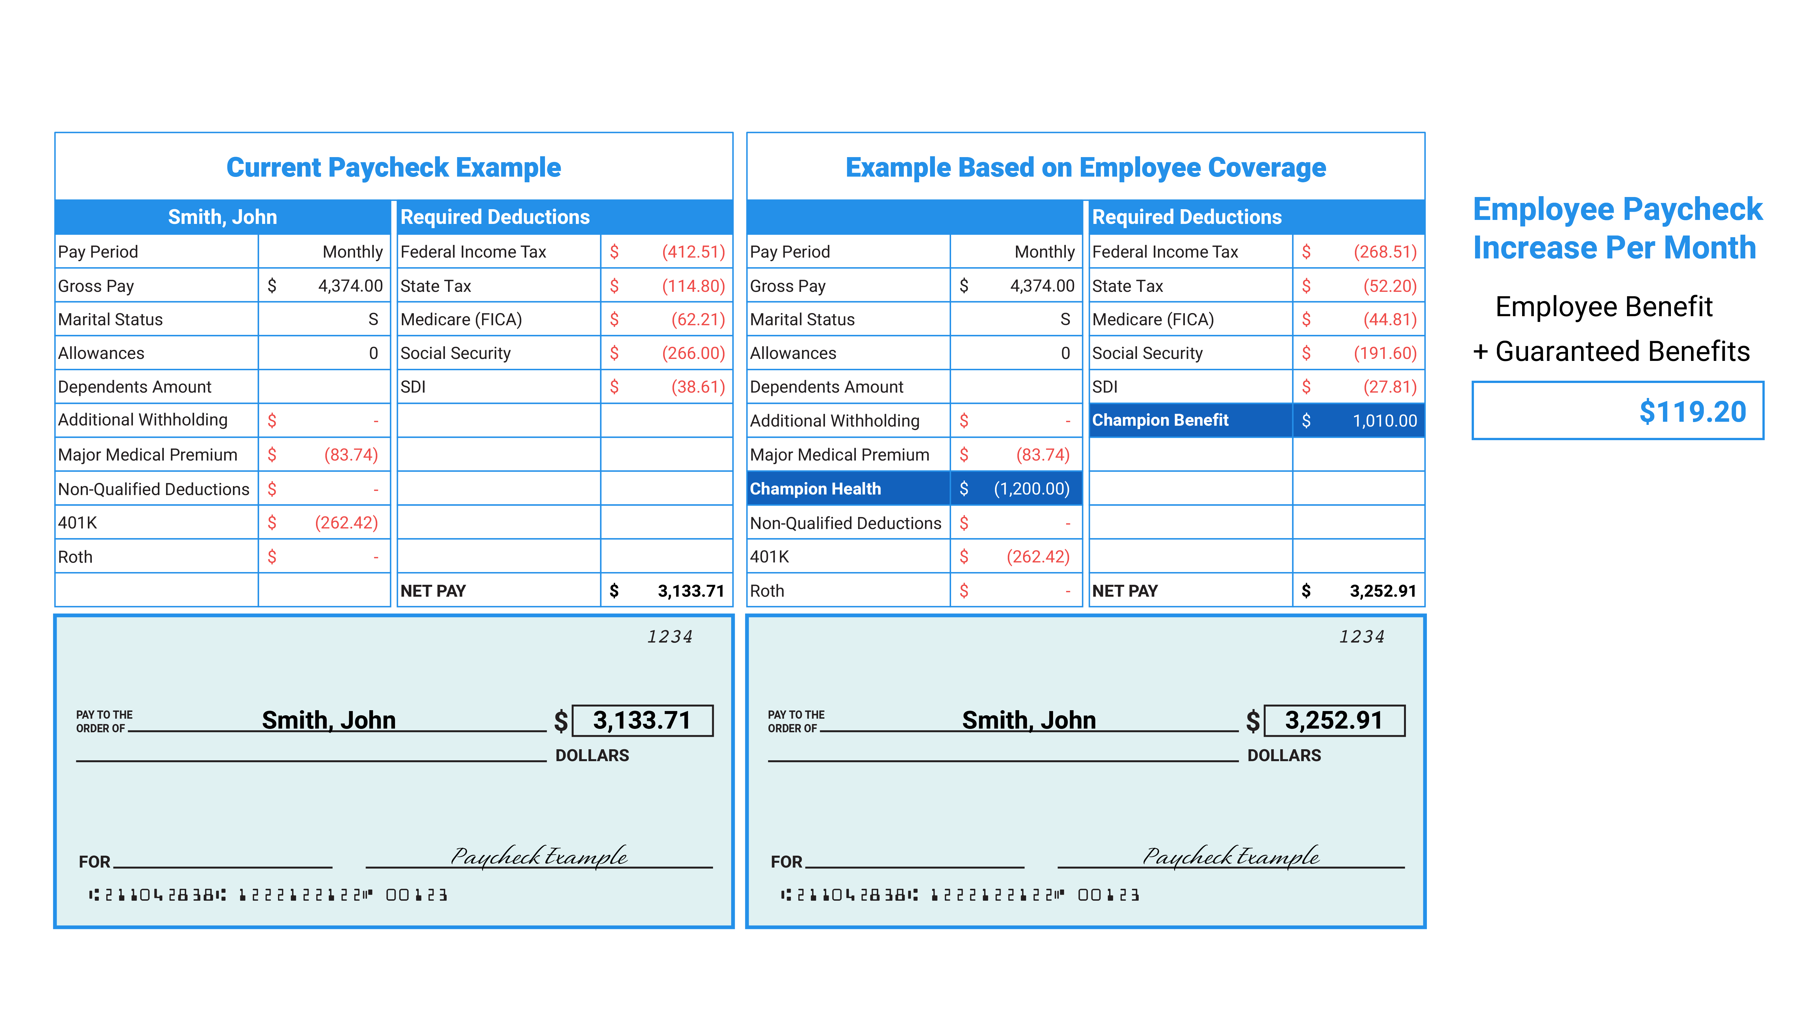
Before and After Employee Paycheck Example
Notes:
Paycheck Example
Let’s run through this paycheck example that I believe will bring clarity to our plan as well. As we look at the current paycheck on the left, we can see “John Smith’s” paycheck. His gross pay was $2,187 per pay period and this a semi-monthly example. There are his current deductions the $41.87 and the $367.08 for a 401k. On the right-hand side, you can see all the FICA and tax deductions as well leaving his net pay at $1,392.64. Let’s move over to the right side for an example of the same employee but who is now enrolled in the Champ Plan. Same gross pay, but now a Champ Claims Funding for $600 has been added. This is the self-funded, self-insured limited schedule plan that is done through a cafeteria 125 plan. Because it falls under the 125 plan it is take on a pre-tax basis. If you look over to the FICA and tax deductions now you will see that all those deductions have decreased relative to the $600 pre-tax Champ Claims Funding portion. As we mentioned earlier very few employees would opt into this plan regardless of the additional benefits if it cost them money out of their paycheck.
That is where the Champ Benefit comes in to make that employee whole on their paycheck. In this example for “John Smith” his net pay increases by $62.92 per pay period or an additional $125.84 per month increase simply by participating in the Champ Plan. This benefit is not a reimbursement it is an indemnity type benefit that is non-taxable. I imagine you are familiar with an Aflac type indemnity benefit. If you were to have a hospital indemnity that pays $3,000 upon a hospital visit that is an indemnity benefit that is triggered by a specific event. The Champ Plan Benefit is very similar to that type of indemnity that has a specific benefit tied to different triggers or diagnostic codes. The events that we talked about earlier as part of the Predictive Med Model trigger different CPT and 213D expenses causing an explanation of benefits. Our technology provides several ways for these triggers to occur that justify the Champ benefit amount. Now to be clear both the claims funding and the benefit amounts are static per pay period. We wish that all employees would jump at our plan simply for the benefits, however we find the monthly increase in their pay to be the initial driving force.
This same initial driving force is what drives the employer as well to be supportive and to push for their employees to participate in the plan. If we turn our attention to the very top of this example, we will see the monetary benefit of the Champ plan to the employer. That Champ Claims Funding that is being fully funded by the employee is on a pre-tax basis, right? This creates a tax savings for the employer as well. They will not have to pay the 7.65% FICA on those claim funding amounts. Now nothing is for free. If I said it was, you would know it was too good to be true and that I was lying. We do have an admin fee for operating and making this plan possible. This example at the top is for a 100-employee business. The $60,000 is the total claims funding by all employees per pay period. The business saves the 7.65% which is the $4,590 per pay period. Less the admin fee which is $44 per employee leaving a net increase of profits for the business of $2,390 per pay period. That would equate to an annual savings of $57,360 for the business. That is an obvious and clear benefit to having this plan.
The not always obvious benefit to the Champ Plan is the long-term benefits. We all know the current healthcare system has room for improvement. One major issue for businesses and employees alike is the premiums just continually rise every year. Reasons for this are varied, but the often-cited ones are the utilization or overutilization of the primary plan. Now that Champ will become the front line of defense absorbing many of the common utilization, but also preventing the bigger ones through the work on the predictive med model. Year after year we will see an offsetting to those rising premiums by reducing the stop loss and in some cases even a decrease in those premiums cause additional savings to employer and employee depending on how your plan is operated.
TRANSITION – Q&A
Let's stop for a moment and see what questions you have on how this plan works and will work for your business.

Slide 12
Employer Savings for 1000 Employees
Potential Annual Savings for Company
$573,600.00
Individual Employee Monthly Breakdown
Claims Funding PPP | $1,200.00
x 7.65 % FICA Payroll Savings | $ 91.80
Less Admin Fee | $ (44.00)
Monthly Per Employee Saving | $ 47.80

Slide 13
Action Items
Initial Census: To produce a proposal/analysis
Request for Coverage (RFC): Company information form completed
Champion Health Plan Documents sent to client and signed by client
Final census completed (with final information including employee contact information
Set up enrollment logistics call with client

